Slide 1


Slide 2

Definition of Apriori Algorithm
Steps to perform Apriori Algorithm
Apriori Algorithm Examples
Pseudo Code for Apriori Algorithm
Apriori Advantages/Disadvantages
References

Slide 3

In computer science and data mining, Apriori is a classic algorithm for learning association rules.
Apriori is designed to operate on databases containing transactions (for example, collections of items bought by customers, or details of a website frequentation).
The algorithm attempts to find subsets which are common to at least a minimum number C (the cutoff, or confidence threshold) of the itemsets.

Slide 4

Apriori uses a "bottom up" approach, where frequent subsets are extended one item at a time (a step known as candidate generation, and groups of candidates are tested against the data.
The algorithm terminates when no further successful extensions are found.
Apriori uses breadth-first search and a hash tree structure to count candidate item sets efficiently.

Slide 5
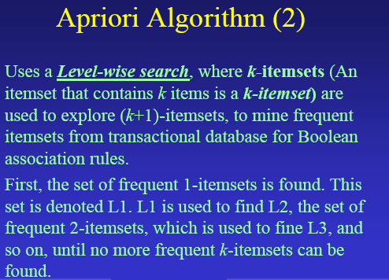

Slide 6

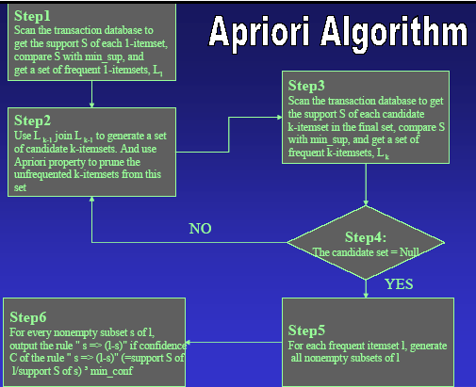

Slide 7

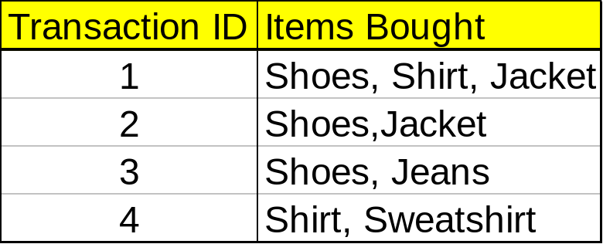
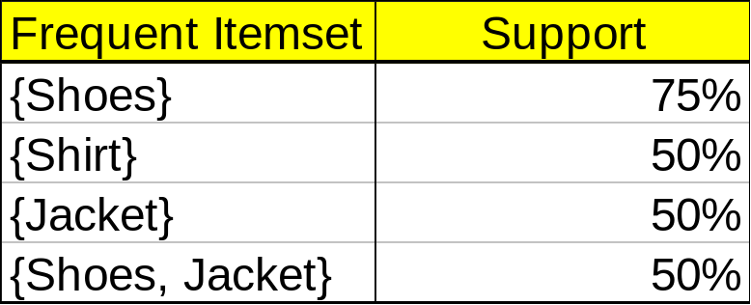
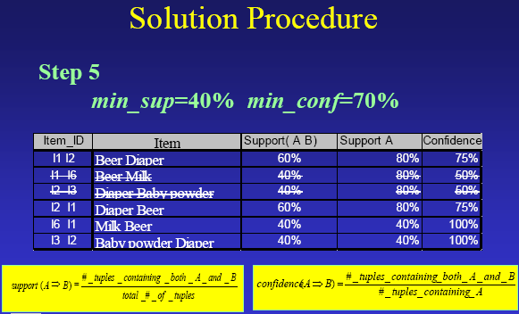
If the minimum support is 50%, then {Shoes, Jacket} is the only 2- itemset that satisfies the minimum support.
If the minimum confidence is 50%, then the only two rules generated from this 2-itemset, that have confidence greater than 50%, are:
Shoes ⇒ Jacket Support=50%, Confidence=66%
Jacket ⇒ Shoes Support=50%, Confidence=100%

Slide 8









Min support =50%
Database D
L₁
C₁
Scan D
C₂
C₂
L₂
Scan D
C₃
Scan D
L₃

Slide 9

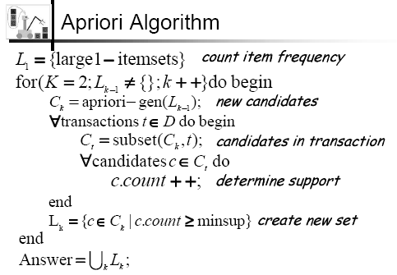

Slide 10

Advantages
  Uses large itemset property
  Easily parallelized
  Easy to implement
Disadvantages
  Assumes transaction database is memory resident.
  Requires many database scans.

Slide 11

Association Rules form an very applied data mining approach.
Association Rules are derived from frequent itemsets.
The Apriori algorithm is an efficient algorithm for finding all frequent itemsets.
The Apriori algorithm implements level-wise search using frequent item property.
The Apriori algorithm can be additionally optimized.
There are many measures for association rules.

Slide 12

References
Agrawal R, Imielinski T, Swami AN. "Mining Association Rules between Sets of Items in Large Databases." SIGMOD. June 1993, 22(2):207-16, pdf.
Agrawal R, Srikant R. "Fast Algorithms for Mining Association Rules", VLDB. Sep 12-15 1994, Chile, 487-99, pdf, ISBN 1-55860-153-8.
Mannila H, Toivonen H, Verkamo AI. "Efficient algorithms for discovering association rules." AAAI Workshop on Knowledge Discovery in Databases (SIGKDD). July 1994, Seattle, 181-92, ps.
Implementation of the algorithm in C#
Retrieved from "http://en.wikipedia.org/wiki/Apriori_algorithm"

